Slide 1
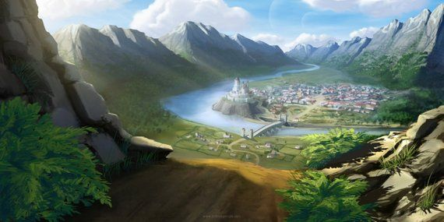
Notes:
1 - Full Town 2 - Town Hall of Basinhold 3 - The Eager Seals Drinking Hall 4 - The Wild Grove Restaurant 5 - The Adore Ore (Magical Blacksmith) 6 - The Whispering Market 7 - The Sweet Pond (Magical MArket)
8 - The Church of Talos

Slide 2
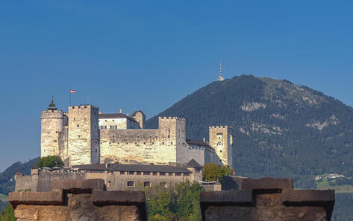
Notes:
1 - Full Town 2 - Town Hall of Basinhold 3 - The Eager Seals Drinking Hall 4 - The Wild Grove Restaurant 5 - The Adore Ore (Magical Blacksmith) 6 - The Whispering Market 7 - The Sweet Pond (Magical MArket)
8 - The Church of Talos

Slide 3
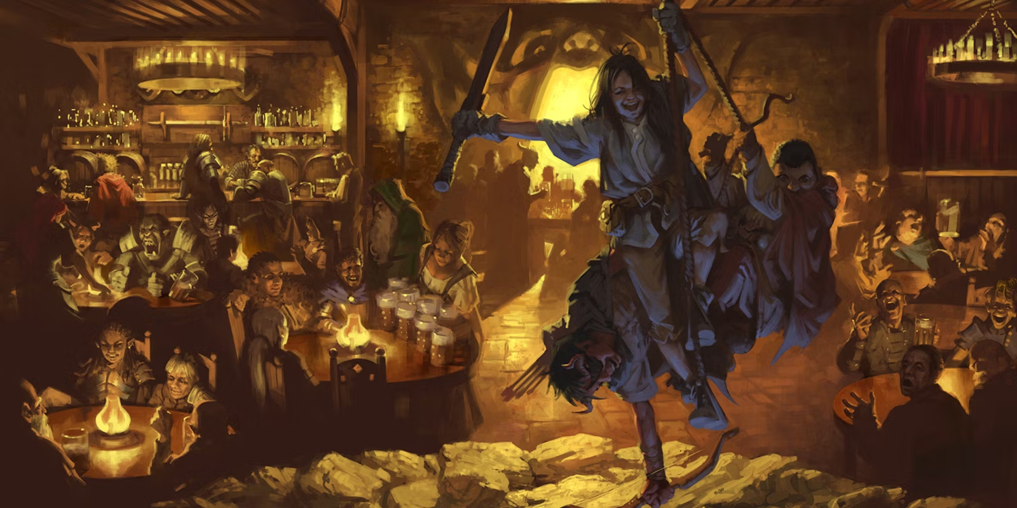
Notes:
1 - Full Town 2 - Town Hall of Basinhold 3 - The Eager Seals Drinking Hall 4 - The Wild Grove Restaurant 5 - The Adore Ore (Magical Blacksmith) 6 - The Whispering Market 7 - The Sweet Pond (Magical MArket)
8 - The Church of Talos

Slide 4
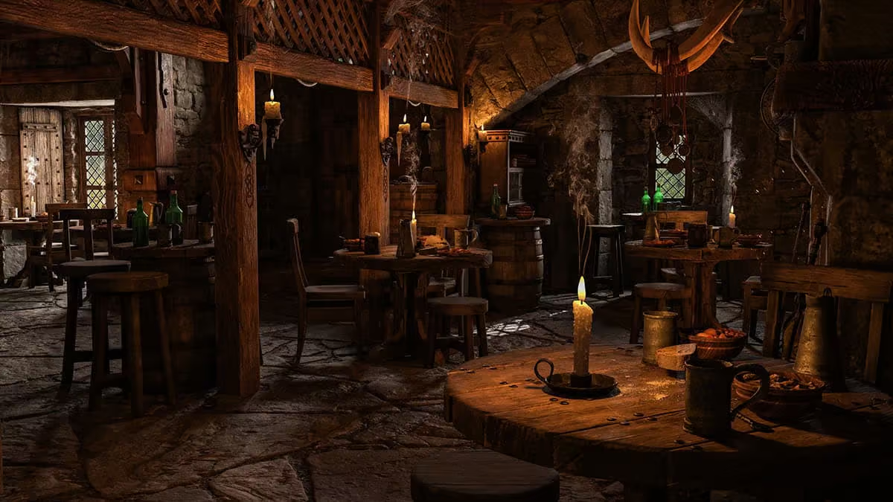
Notes:
1 - Full Town 2 - Town Hall of Basinhold 3 - The Eager Seals Drinking Hall 4 - The Wild Grove Restaurant 5 - The Adore Ore (Magical Blacksmith) 6 - The Whispering Market 7 - The Sweet Pond (Magical MArket)
8 - The Church of Talos

Slide 5
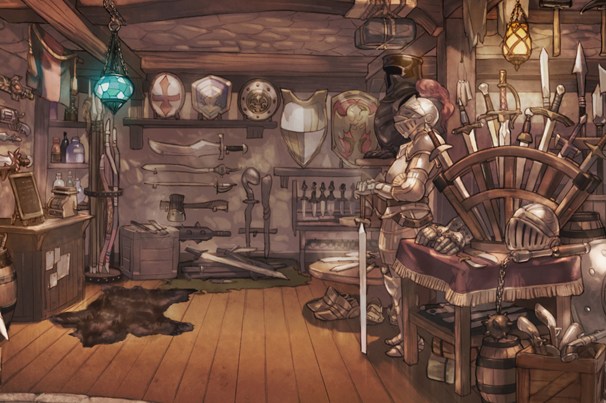
Notes:
1 - Full Town 2 - Town Hall of Basinhold 3 - The Eager Seals Drinking Hall 4 - The Wild Grove Restaurant 5 - The Adore Ore (Magical Blacksmith) 6 - The Whispering Market 7 - The Sweet Pond (Magical MArket)
8 - The Church of Talos

Slide 6
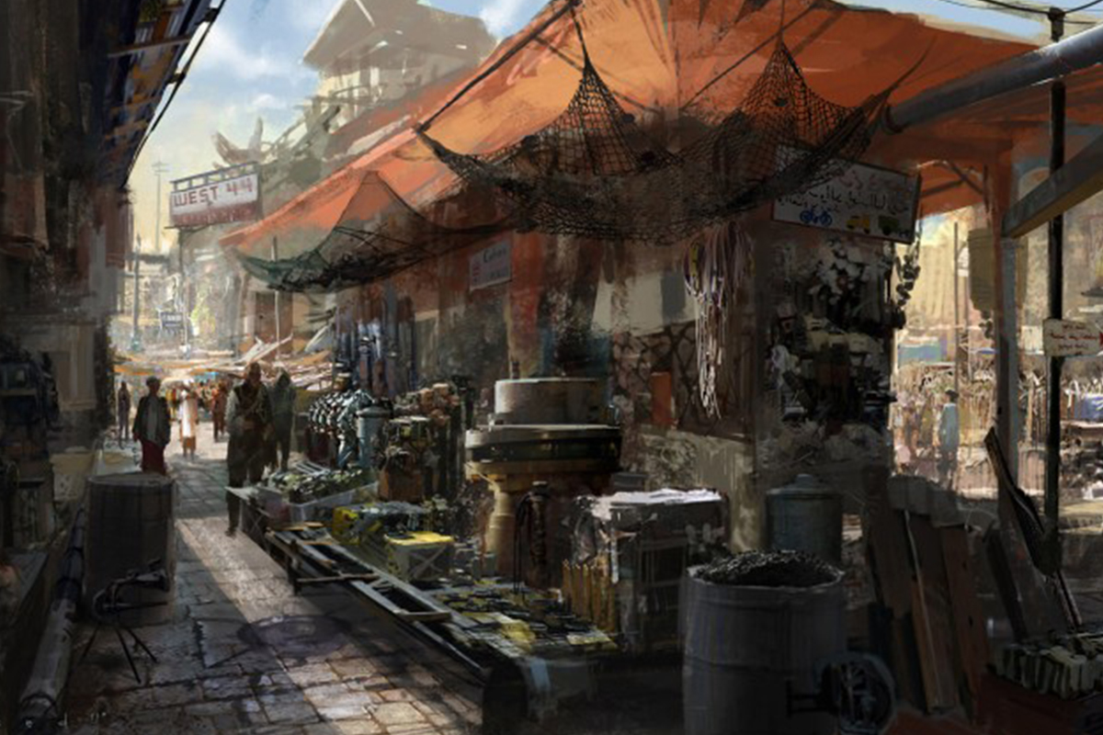
Notes:
1 - Full Town 2 - Town Hall of Basinhold 3 - The Eager Seals Drinking Hall 4 - The Wild Grove Restaurant 5 - The Adore Ore (Magical Blacksmith) 6 - The Whispering Market 7 - The Sweet Pond (Magical MArket)
8 - The Church of Talos

Slide 7
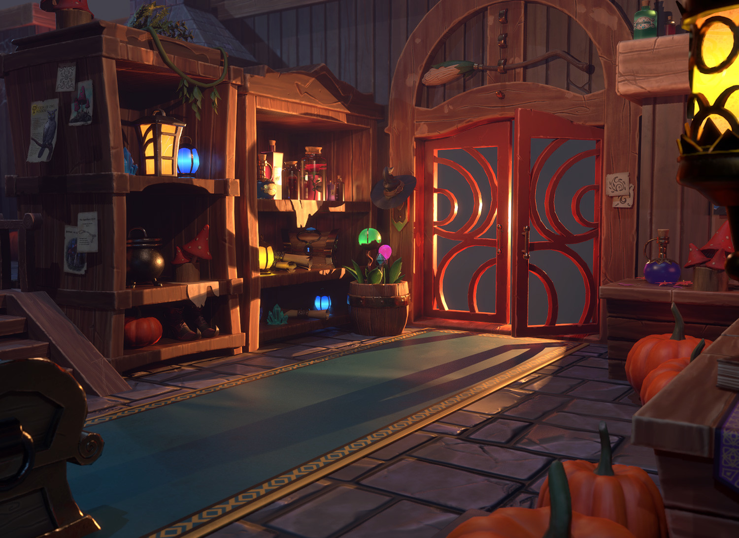
Notes:
1 - Full Town 2 - Town Hall of Basinhold 3 - The Eager Seals Drinking Hall 4 - The Wild Grove Restaurant 5 - The Adore Ore (Magical Blacksmith) 6 - The Whispering Market 7 - The Sweet Pond (Magical MArket)
8 - The Church of Talos

Slide 8
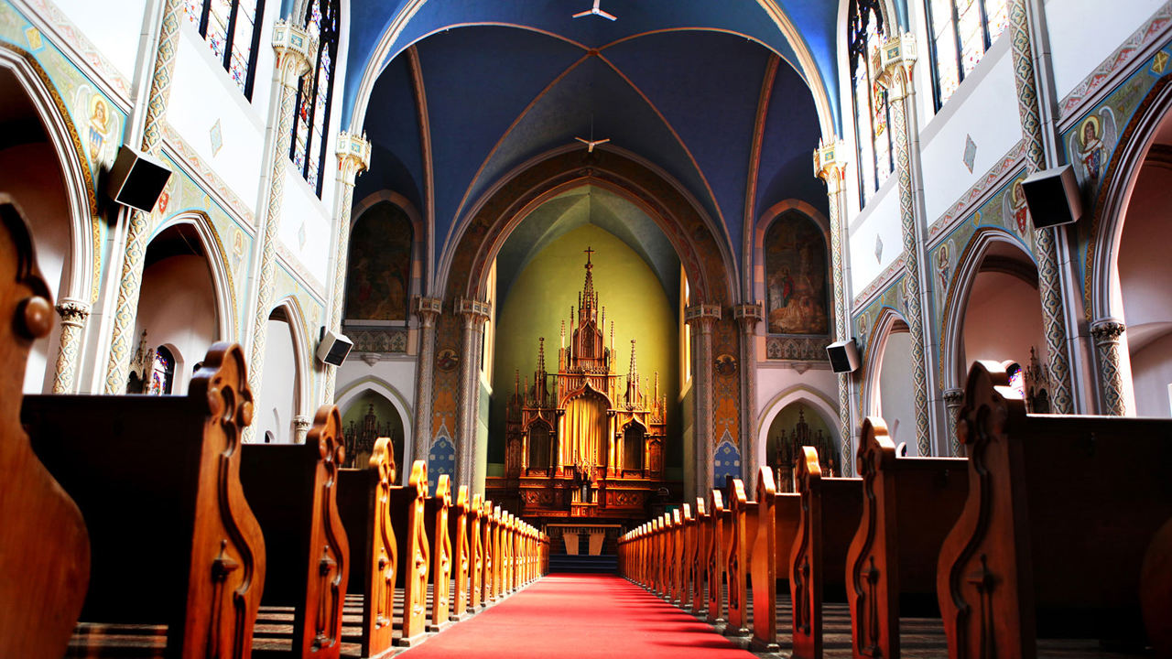
Notes:
1 - Full Town 2 - Town Hall of Basinhold 3 - The Eager Seals Drinking Hall 4 - The Wild Grove Restaurant 5 - The Adore Ore (Magical Blacksmith) 6 - The Whispering Market 7 - The Sweet Pond (Magical MArket)
8 - The Church of Talos

